Slide 1


Debt Collection
Team A
Patrick Meade, Sumatra Dhimoyee, Quan Ho, Yiyang Cai,
Andrew Woska - Team Rep

Slide 2
Project Background
Description of the project:
There is a lack of comprehensive investigation regarding debt collection procedures within the Massachusetts court system.
By analyzing archived records, we can gain insight into how debt collection operates within the courts of Massachusetts
Looking at debt collection across the state of Massachusetts and looking into key questions provided to by WBGH
Exploring new paths to figure out what creates a debt collection case

Slide 3
Project Deliverables
How many cases have been filed in the past 10 years?
What percentage of cases in small claims and district court are filed by debt collectors?
Who are the debt collectors?
How many cases go into default?
How many debtors are pro se?
How many cases end up with wage garnishes?
How many cases lead to capias warrants?
How many debt cases were there in the past 10 years in the database? What percentage is that in the past 10 years
What happens to defendants, such as wage garnishes and capias warrants percentages?
When there is a default, how often is there a judgment?
What’s the 10-year YoY look of capias warrants and wage garnishes?

Slide 4
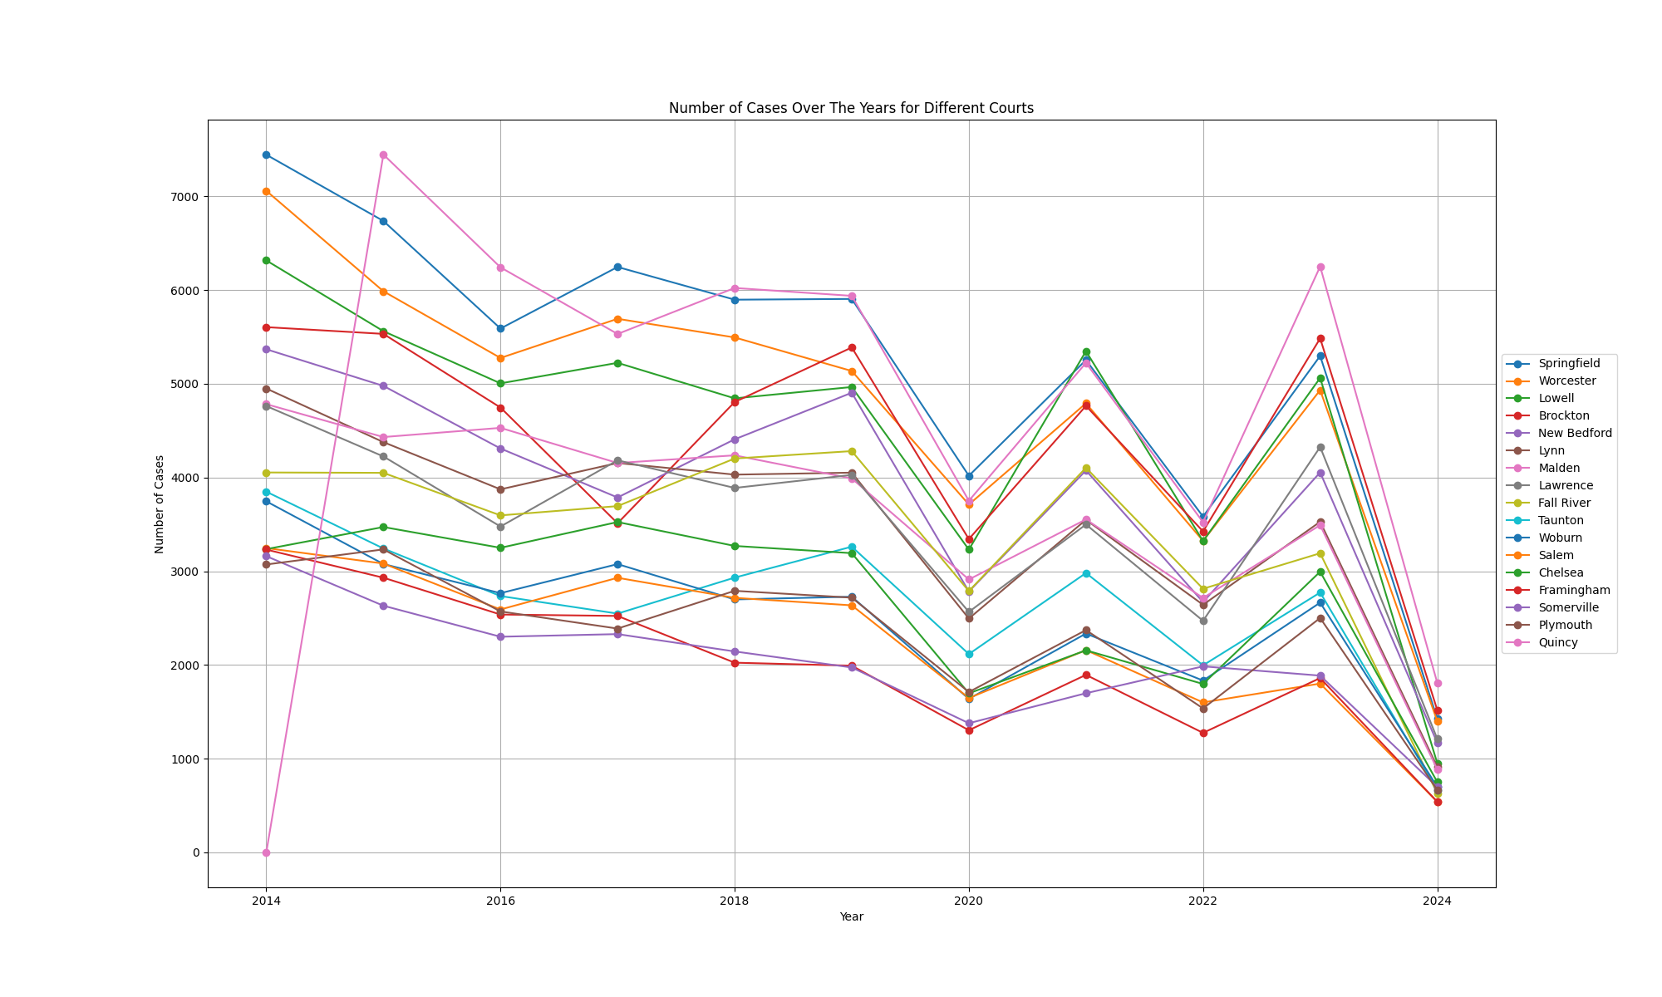
TOTAL number of Cases by District Court
Representing the number of debt case by District court
Quincy has held the most number of cases in 2015 and has consistently held one of the top positions in the most amount of cases per year.
Note:
2024 Data is not complete
Graph only represents Courts with an average number of cases greater than 2000.

Slide 5
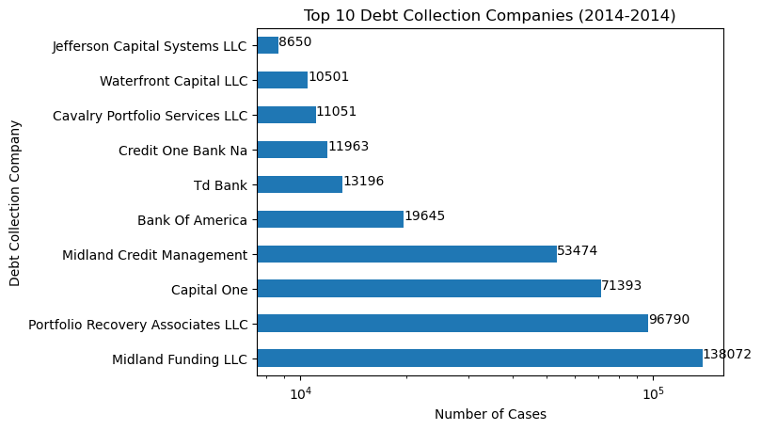
Debt collection companies
Debt Collectors (licensed 2013-2023)
1106 companies licenced in MA
117 companies filing in small claims and civil courts
>472,292 debt collection cases in the last 10 years
17.0% of all court cases

Slide 6
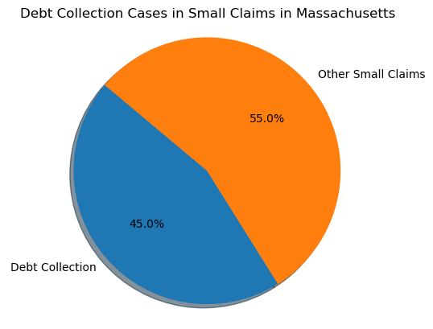
small claims and district court
Using compiled list of all known debt collectors operating in Massachusetts from 2017-2023:
From 2014-2024
843,910 cases in small claims
379,846 debt collection cases as of April 30th
>45.0% of small claims court
Assumes all debt collection companies do is debt collection

Slide 7
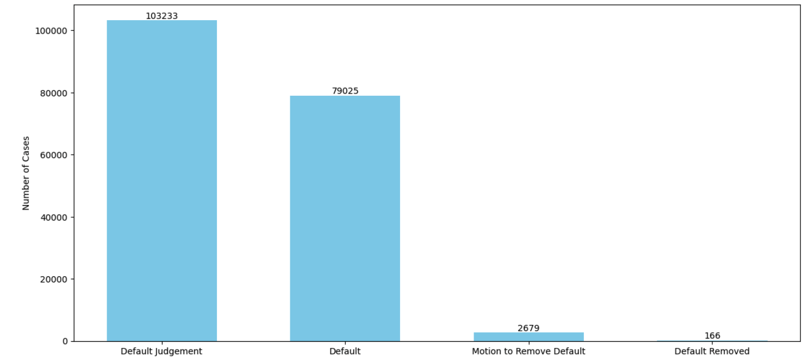
ANALYSIS of DEFAULT CASES
Demonstrates the default cases in last 11 years starting 1st Jan 2013
Percentage of default cases to debt case: 28.43
Number of cases that gets default judgment are high
Alarmingly, only few are successful in being able to remove default judgement

Slide 8
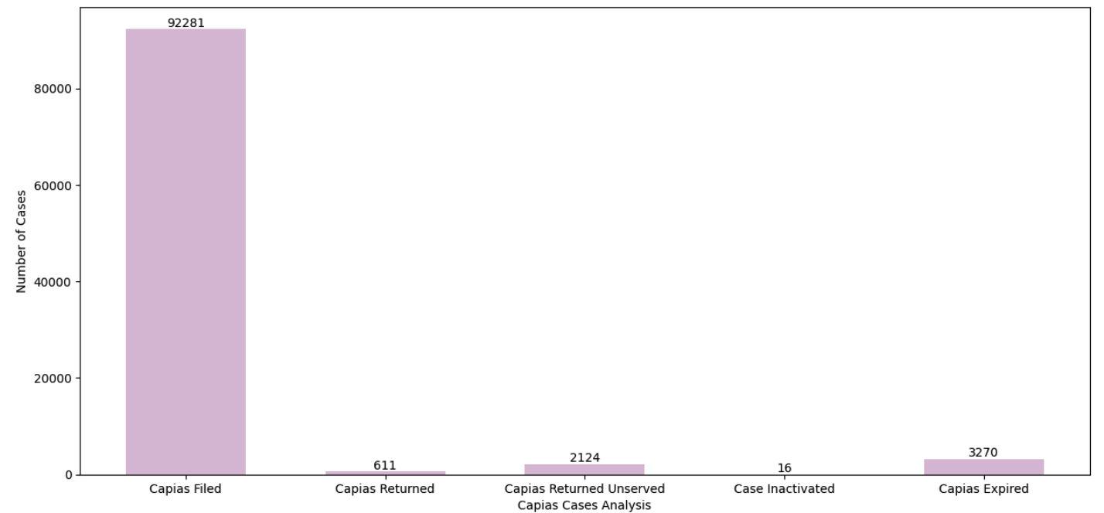
ANALYSIS OF CAPIAS CASES
Demonstrates the default cases in last 11 years starting 1st Jan 2013
Percentage of capias cases that are debt case: 31.85
While high number of cases gets filed for capias
Only 0.006% of cases is successful in serving the capias
Number of capias that comes unserved is about 3X to those that gets served

Slide 9
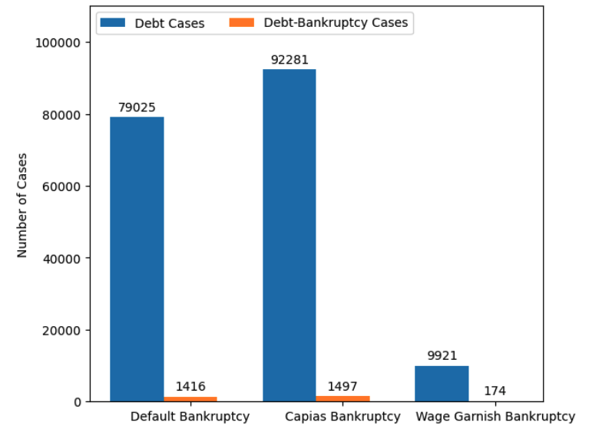
ANALYSIS to BankRUPTCY case
Number of cases that files for bankruptcy are significantly small
Number of default cases that files bankruptcy: 1416
Number of capias cases that files bankruptcy: 1497
Number of wage cases that files bankruptcy: 174

Slide 10
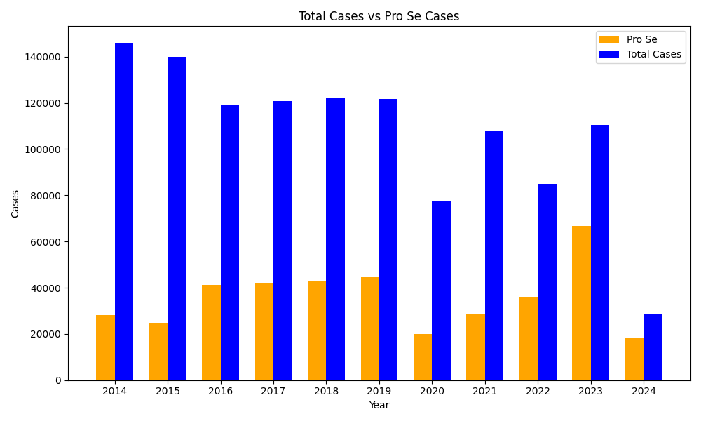
PRo SE VS TOTAL CASES
Representing all the cases per year and comparing them to the Pro Se cases of that year
Over the last decade there has been a total of 393,817 pro se cases and counting.
The most Pro Se cases was in 2023 at: 66,846 cases
Note: 2024 Data is not complete

Slide 11
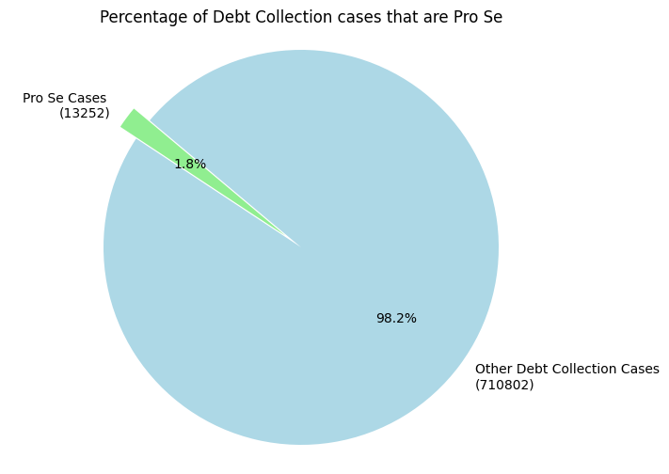
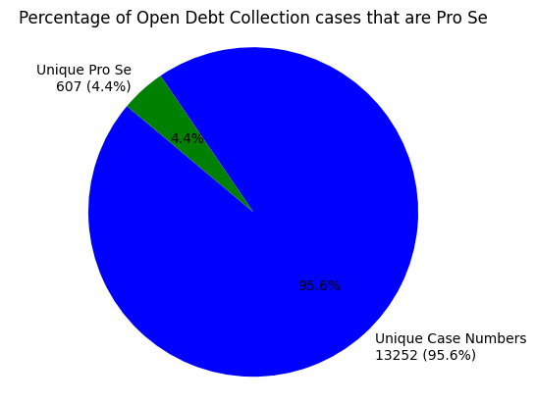
PRo SE Debt collection cases
There are currently 145,102 total Pro Se cases that are related to debt collection with 607 cases that are still open.

Slide 12
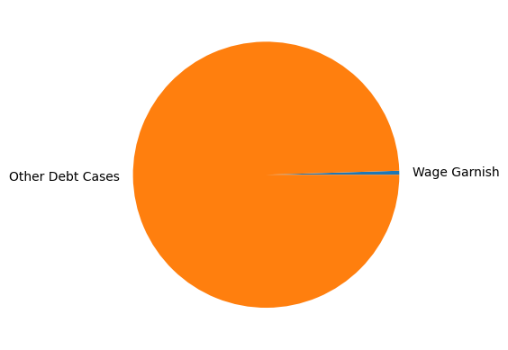
Wage Garnishes VS TOTAL CASES
Representing all the cases ending in Wage Garnish
For all the data with relevance to Debt Cases only 1359 cases of Wage Garnish is found in the Wp_cdc database vs almost 290000 other debt cases.

Slide 13
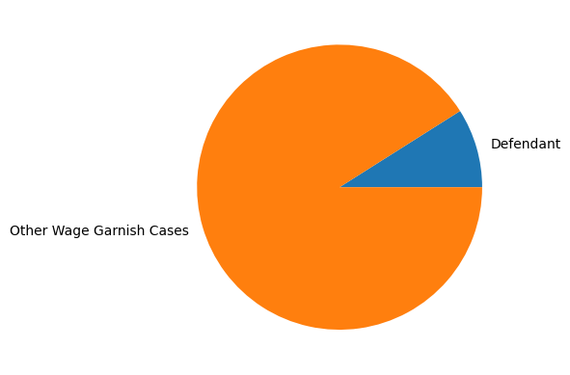
DEFENDANT VS OTHER
Out of all Case end up in Wage Garnish about 7% are Defendants. This case is similar in the Capias Warrants.

Slide 14
Future steps
Improve database to make query searches run faster.
Create tables to produce one instance of case number with all information available in that row.
Improve database with better servers.
Create GUI or application that reads and loads top line statistics of cases(ex: case number, defendant names, attorney names).
Looking into more trends or correlations between debt collection companies and their debtors.

Slide 15

Thank you!

